Slide 1
Short Course in Linguistics
Intro to Phonetics

Slide 2
Aims
Introduction to some of the core principles of:
Linguistics
Computational Linguistics

Slide 3
Topics
Phonetics and Phonology
Morphology
Syntax
Semantics
Identity

Slide 4
Some recurring themes...
Languages are extremely diverse
Over 7000 languages worldwide
No person ever has full mastery of the language they use
Most people in the world speak more than one language
43% bilingual
13% trilingual
3% quadrilingual
1% are polyglots...

Slide 5
What is language?
Complex, mutually agreed system for linking form to meaning
Arbitrary
Universal amongst humans
Hierarchical
Constantly changing

Slide 6
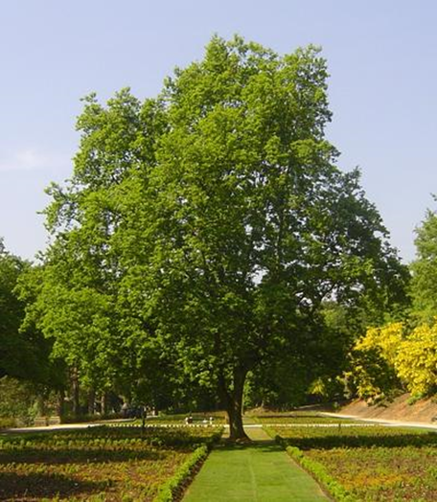
Arbitrariness of Language
árbol
شجرة
shū
Дерево
yugu
Baum
lignum
ağaç

Slide 7
Onto today’s topic...

Slide 8
Phonetics and Phonology
Phonetics
‘the study and classification of speech sounds’
Phonology
‘the study of relationships among the speech sounds of a language’

Slide 9
How do we produce speech sounds?
Majority of speech sound created by releasing air from the lungs through the mouth or nose
We use the stream of air, vocal chords and different configurations of the mouth
Two different types of sounds
Consonants – use the mouth to restrict the flow of air
Vowels – allow free flowing

Slide 10
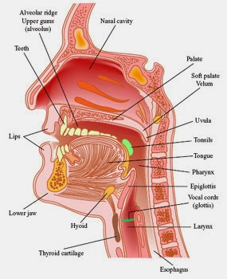
The vocal tract

Slide 11
Consonants
Consonants are characterised in two ways:
Place of articulation – where we impede the flow of air
Manner of articulation – the way in which we impede the flow of air

Slide 12
Segue
For the rest of this hour, you need to suspend any notion you have that you may know how to spell
We’ll be spelling things exactly as they sound, using the International Phonetic Alphabet (IPA)
Hopefully you all have an IPA sheet to read from...

